Slide 1

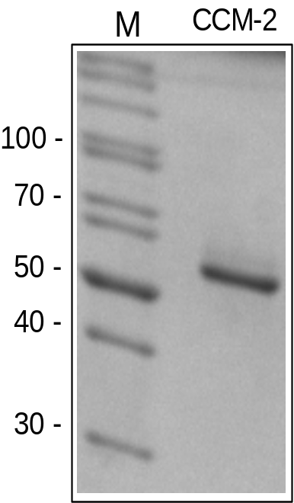
Reliatech GmbH
Recombinant human CCM-2
(Cat #300-055)
Fig. 1: SDS-PAGE analysis of recombinant human CCM-2 derived from E. coli. Sample was loaded in 15% SDS-polyacrylamide gel under reducing conditions and stained with Silver stain.
http://www.reliatech.de / orders@reliatech.de

